Slide 1

Sublinear-Time Algorithms
for Random-Walk Probability Estimation
Zhewei Wei
Renmin University of China
May 17, 2024

Slide 2
Outline
1
Background
2
Problems and Contributions
3
Techniques
4
Perspectives

Slide 3
Outline
1
Background
2
Problems and Contributions
3
Techniques
4
Perspectives

Slide 4

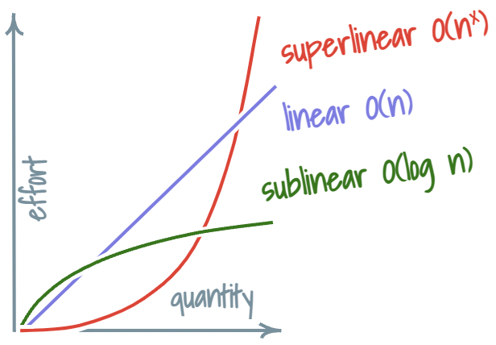
Background
How to Process Data at a Massive Scale?
1. Hardware Advances
2. Algorithm Improvements
Acquiring more servers.
Cons:
Developing efficient algorithms
Pros:
enormous costs,
huge energy consumption
cost-saving,
energy-efficient
V.S.
Trend of Electricity Consumption

Slide 5
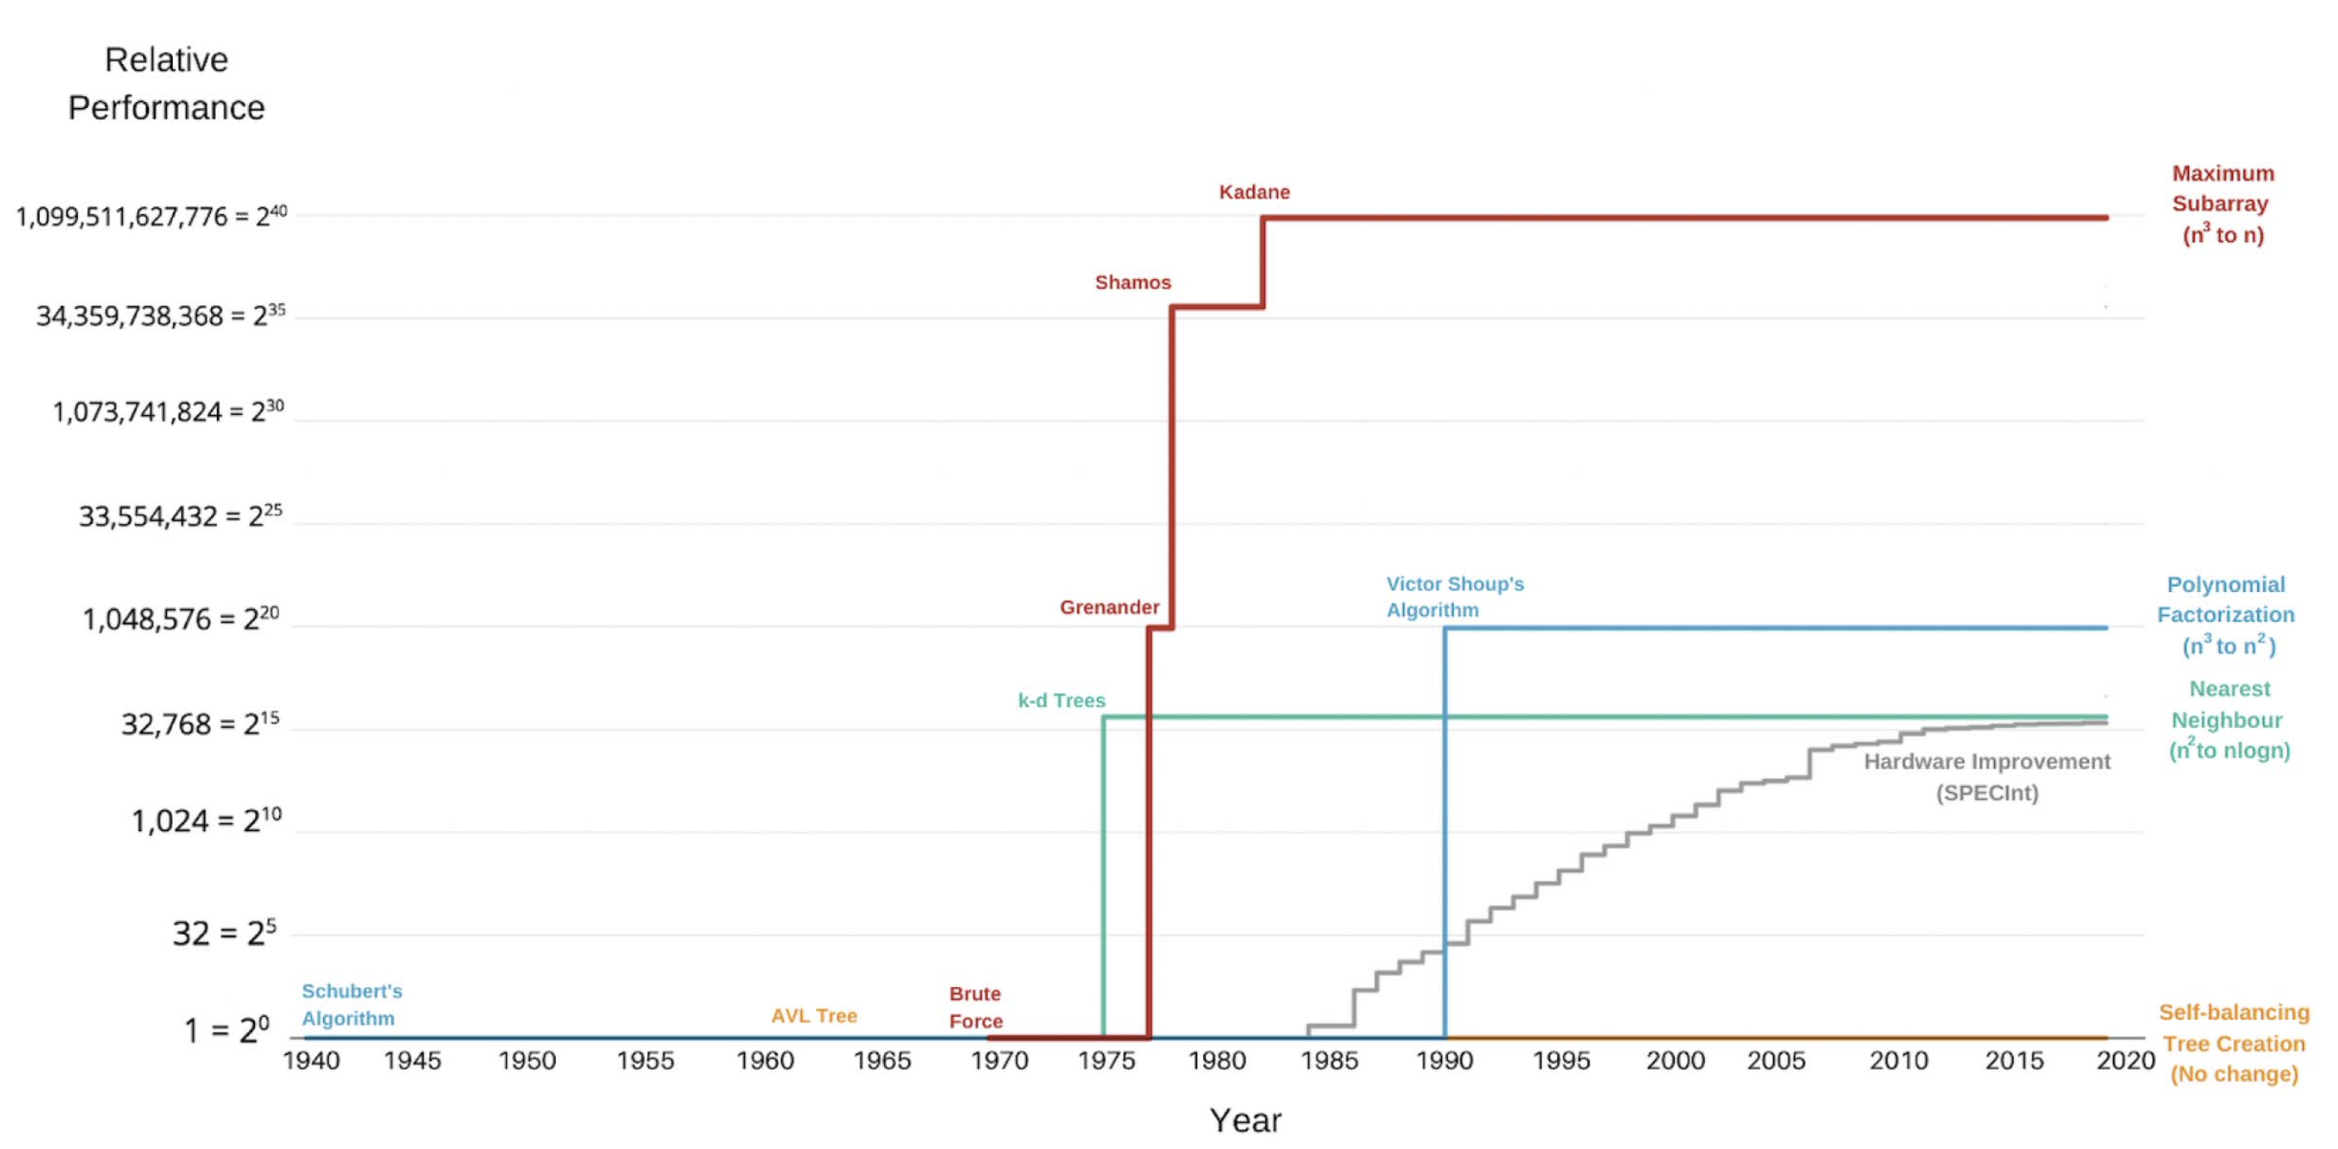
Background
MIT Computer Science & Artificial Intelligence Laboratory:
Performance gains due to algorithmic improvements have exceeded those due to hardware improvements.
Performance gains due to the algorithmic improvement of Maximum Subarray problem
The impact of algorithmic improvement for Polynomial Factorization
Hardware improvement

Slide 6


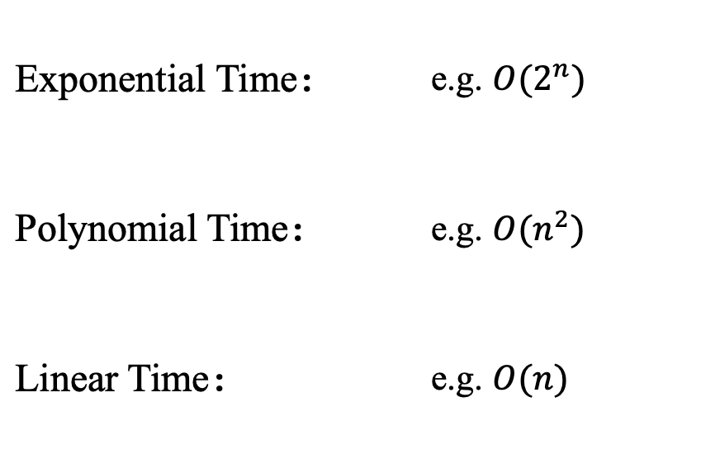
Background
The Massive Data Volume Challenges
the Classical Notion of Efficient Algorithms
by the winner of Gödel Prize, Prof. Shang-Hua Teng
Exponential Time： | e.g. $O(2^{n})$
Polynomial Time： | e.g. $O(n^{2})$
Linear Time： | e.g. $O(n)$
Inefficient
Big Data Notion
Classical Notion.
Inefficient
Efficient
Efficient

Slide 7

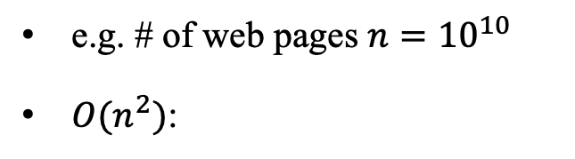
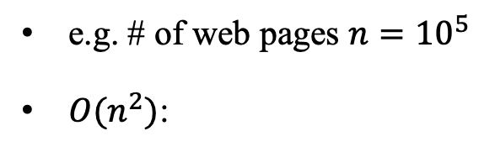
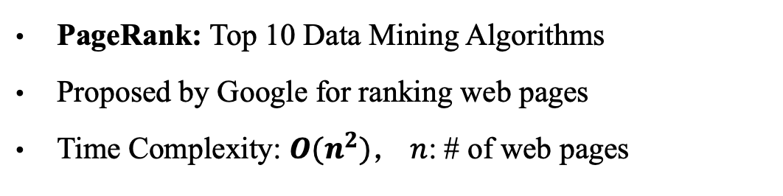
Background
The Massive Data Volume Challenges
the Classical Notion of Efficient Algorithms
PageRank: Top 10 Data Mining Algorithms
Proposed by Google for ranking web pages
Time Complexity: $O(n^{2})$， $n$: # of web pages
In the Early Stage
Contemporary Internet
e.g. # of web pages $n={10}^{5}$
$O(n^{2})$:
e.g. # of web pages $n={10}^{10}$
$O(n^{2})$:
completed in 10 s with a single server
completed in 3 years using 100 servers!

Slide 8
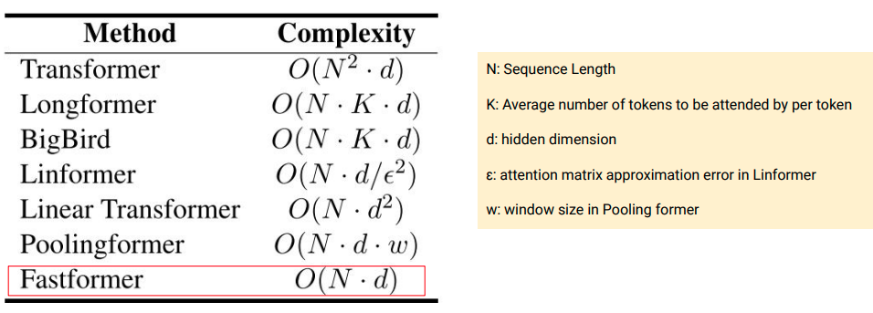
Background
Machine Learning Challenges
the Classical Notion of Efficient Algorithms

Slide 9
Motivations
Designing Scalable Algorithms for P Problems
by the winner of Gödel Prize, Prof. Shang-Hua Teng
Class NP
Class P
Class S
❓
Verifiable
in Polynomial Time
Solvable
in Polynomial Time
Capable
to handle big inputs
(nearly linear or sub-linear)
Focus: Random-Walk Probability Estimation on Large Graphs

Slide 10
Outline
1
Background
2
Problems and Contributions
3
Techniques
4
Perspectives

Slide 11


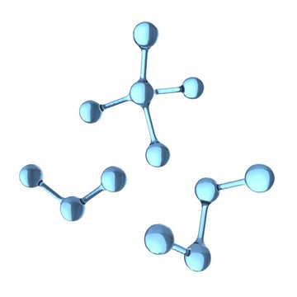

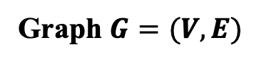
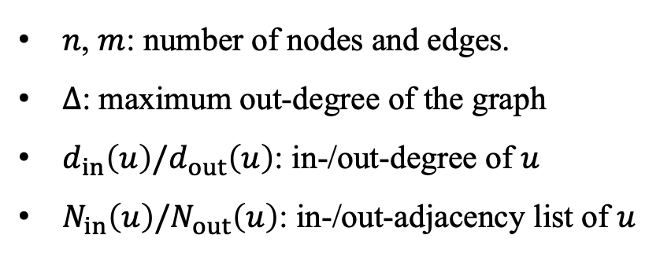
Graphs
a node
an edge
Social Network
Transportation Network
Graph $G=(V,E)$
$n$, $m$: number of nodes and edges.
$∆$: maximum out-degree of the graph
$d_{in}\left(u\right)/d_{out}\left(u\right)$: in-/out-degree of $u$
$N_{in}\left(u\right)/N_{out}\left(u\right)$: in-/out-adjacency list of $u$
Protein Structure
Trade Network

Slide 12
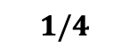
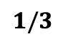
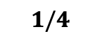
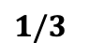
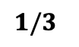
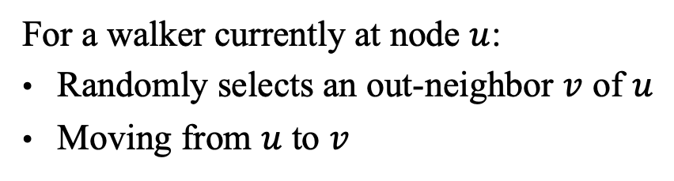
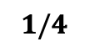
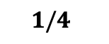
Random Walks on Graphs
10
9
12
2
1
8
3
11
$$1/3$$
$$1/3$$
4
$$1/4$$
$$1/3$$
$$1/4$$
For a walker currently at node $u$:
Randomly selects an out-neighbor $v$ of $u$
Moving from $u$ to $v$
6
5
$$1/4$$
$$1/4$$
7

Slide 13
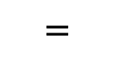
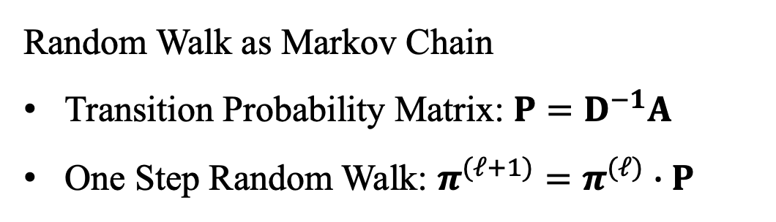
Random Walks on Graphs
2
Random Walk as Markov Chain
Transition Probability Matrix: $P=D^{−1}A$
One Step Random Walk: $π^{(ℓ+1)}=π^{(ℓ)}∙P$
3
1
4
6
5
7
0 | 1/3 | 1/3 | 1/3 | 0 | 0 | 0
$$=$$
1 | 0 | 0 | 0 | 0 | 0 | 0
 | 1/3 | 1/3 | 1/3
 |  | 1
 |  |  |  |  | 1
 |  |  |  |  | 1
 |  |  | 1/2 |  |  | 1/2
 |  |  |  | 1
 |  |  |  |  | 1

Slide 14

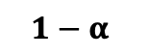


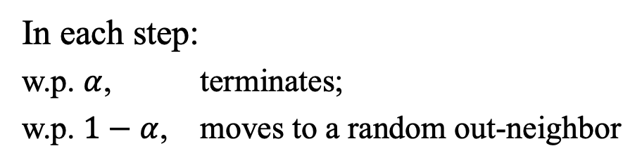
$α$-Discounted Random Walks ($α$-Walks)
10
9
12
2
1
8
3
11
$$α$$
4
$$1−α$$
Damping Factor $α∈(0,1)$
6
5
In each step:
w.p. $α$, terminates;
w.p. $1−α$, moves to a random out-neighbor
$$1−α$$
7

Slide 15
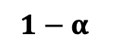

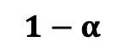
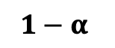
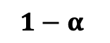
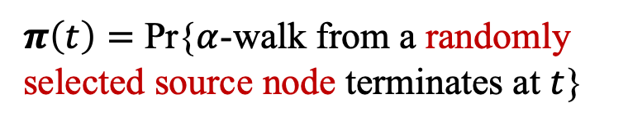
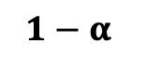
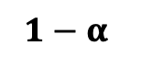
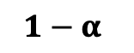


PageRank
Uniformly Sampling a Source Node …
Uniformly Sampling a Source Node …
Uniformly Sampling a Source Node …
10
10
Sampled!
9
9
$$1−α$$
12
12
2
$$1−α$$
2
$$α$$
8
1
8
1
Sampled!
11
3
$$1−α$$
11
3
$$α$$
$$1−α$$
4
$$1−α$$
4
Node $t$’s PageRank Score
$$1−α$$
$$1−α$$
6
6
5
5
Sampled!
$π\left(t\right)=$ Pr{$α$-walk from a randomly selected source node terminates at $t$}
$$1−α$$
7
7
$$α$$

Slide 16
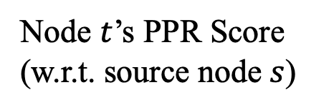

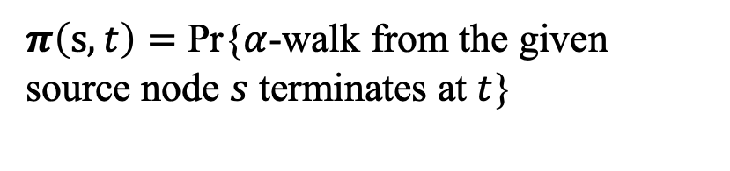

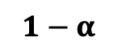
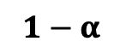
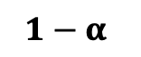
Personalized PageRank (PPR)
10
9
12
2
$$1−α$$
1
8
3
11
$$α$$
4
$$1−α$$
$$1−α$$
$$1−α$$
Node $t$’s PPR Score (w.r.t. source node $s$)
Given a
Source Node
6
$$α$$
5
$π\left(s,t\right)=$ Pr{$α$-walk from the given source node $s$ terminates at $t$}
$$1−α$$
7

Slide 17

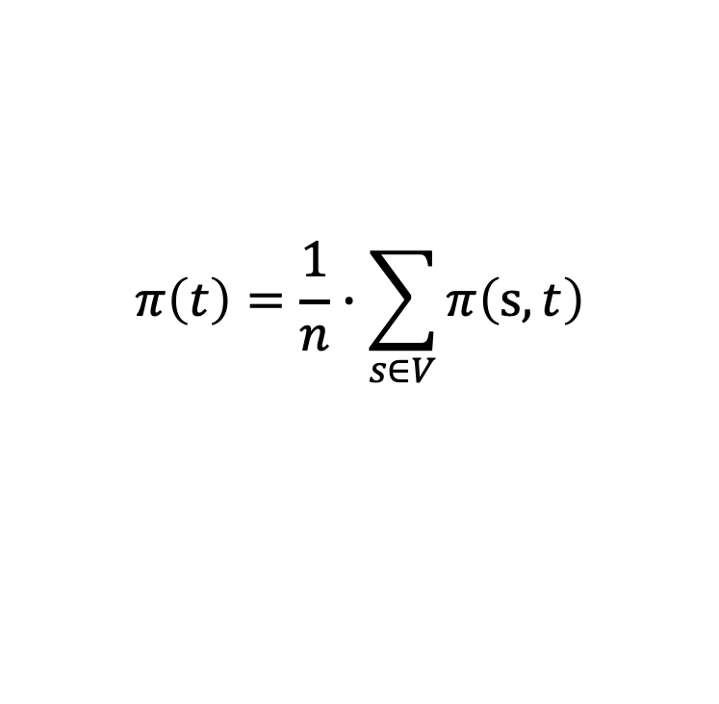



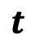

PageRank and PPR
$$π\left(t\right)=\frac{1}{n}∙\sum_{s∈V}{π\left(s,t\right)}$$
PageRank $π(t)$
PPR $π(s,t)$
$$t$$
$$t$$
$$s$$
Random Source Node
Given a Source Node $s$

Slide 18

Definition Formula
$$π=\left(1−α\right)π∙P+αx$$
PageRank/PPR Vector
Initial Distribution
Damping Factor
Transition Matrix
1/n | 1/n | 1/n | 1/n | 1/n | 1/n | 1/n
If vector $x=$ , $π$ is PageRank vector.
0 | 0 | 0 | 0 | 1 | 0 | 0
If vector $x=$ , $π$ is PPR vector.

Slide 19
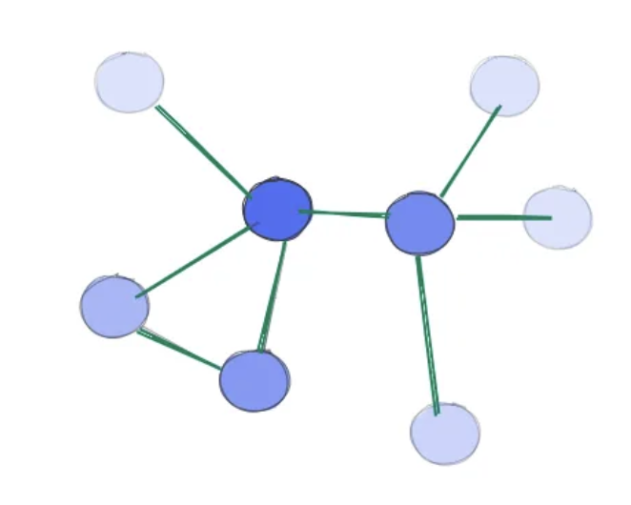

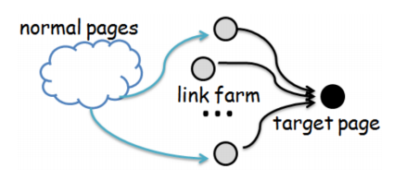
Applications
Graph Theory and Network Analysis
Graph Centrality Evaluation [CIKM’08, FOCS’18]
Friend Recommendation (Twiter Who-to-Follow) [WWW’13]
Named Entity Disambiguation [ACL’15]
Spam Detection [KDD’12]

Slide 20

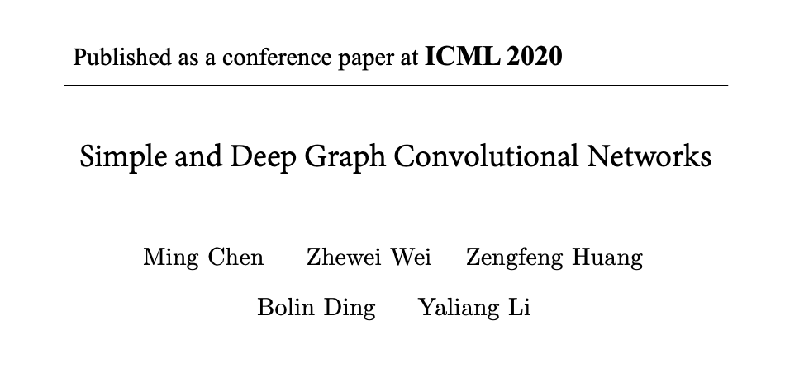
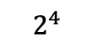
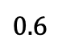

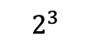
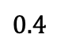
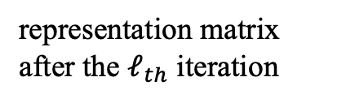
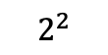
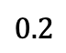
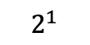
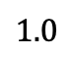
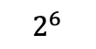




Applications
Graph Neural Networks (GNNs)
Prediction Accuracy
$$1.0$$
$$0.8$$
$$0.6$$
$$0.4$$
GCNII
GCN
Training Layers
$$0.2$$
representation matrix after the $ℓ_{th}$ iteration
$$2^{1}$$
$$2^{2}$$
$$2^{3}$$
$$2^{4}$$
$$2^{5}$$
$$2^{6}$$
PageRank Definition Formula:
$π=\left(1−α\right)π∙P+αx$
GCN:
$H^{(ℓ+1)}=σ\left(W^{(𝓁)}∙H^{(ℓ)}∙P\right)$
GCNII:
substitute
$$\left(1−α\right)H^{(ℓ)}∙P+αH^{(0)}$$

Slide 21




Query Types
Given a
Target Node
Single-Node Random-Walk Probability Computations
Estimating $π(t)$
$$t$$
Single-Target Random-Walk Probability Computations
Uniformly
Sampled!
Single-Source Random-Walk Probability Computations
Goal:
Given a target node $t$, estimating $π(t)$
$$\operatorname{Pr}\left\{\left|π(t)\text{ − }\hat{π}(t)\right|>c∙π\left(t\right)\right\}≤p_{f}$$

Slide 22


Query Types
Given a
Target Node
Single-Node Random-Walk Probability Computations
$$t$$
Single-Target Random-Walk Probability Computations
Single-Source Random-Walk Probability Computations
Goal: Given a target node $t$, estimating $π(u,t)$ for each node $u$ in the graph.

Slide 23



Query Types
Single-Node Random-Walk Probability Computations
$$s$$
Single-Target Random-Walk Probability Computations
Given a Source Node $s$
Single-Source Random-Walk Probability Computations
Goal: Given a source node $s$, estimating $π(s,u)$ for each node $u$ in the graph.

Slide 24




Problem Definition
Single-Node PageRank Estimation
Given a
Target Node
Estimating $π(t)$
$$t$$
Goal:
Given a target node $t$, estimating $π(t)$
Uniformly
Sampled!
$$\operatorname{Pr}\left\{\left|π(t)\text{ − }\hat{π}(t)\right|>c∙π\left(t\right)\right\}≤p_{f}$$

Slide 25





Graph Access Model
$$u$$
$$v$$
Indeg ($u$): return the in-degree of $u$
Uniformly
Sampled!
Outdeg ($u$): return the out-degree of $u$
InNbr ($u,i$): return the $i_{th}$ in-neighbor of $u$
OutNbr ($u,i$): return the $i_{th}$ out-neighbor of $u$
Jump (): return a uniformly sampled node

Slide 26









Our Contributions
Optimal Algorithm for Single-Node PageRank Estimation
KDD 2014/WSDM 2016
FOCS 2018
SICOMP 2023
STOC 2024 (Ours)
upper bound
$O\left({\left(\frac{\sum_{u∈V}{π\left(u,t\right)∙}d_{in}\left(u\right)}{π\left(t\right)}\right)}^{\frac{1}{2}}\right)$
upper bound
$$\tilde{O}\left(min⁡\{n^{\frac{3}{4}}Δ^{\frac{1}{4}}, n^{\frac{5}{7}}m^{\frac{1}{7}}\}\right)$$
upper bound
$\tilde{O}\left(min⁡\{n^{\frac{2}{3}}Δ_{ }^{\frac{1}{3}}, n^{\frac{2}{3}}m^{\frac{1}{6}}\}\right)$
upper bound
$$O\left(min⁡\{{n^{\frac{1}{2}}Δ}_{ }^{\frac{1}{2}}, {n^{\frac{1}{2}}m}^{\frac{1}{4}}\}\right)$$
$Ω\left(min⁡\{{n^{\frac{1}{2}}Δ}_{ }^{\frac{1}{2}}, {n^{\frac{1}{2}}m}^{\frac{1}{4}}\}\right)$
$Ω\left(min⁡\{n^{\frac{1}{2}}Δ_{ }^{\frac{1}{2}},{n^{\frac{1}{3}}m}^{\frac{1}{3}}\}\right)$
$Ω\left(min⁡\{n^{\frac{1}{2}}Δ_{ }^{\frac{1}{2}},{n^{\frac{1}{3}}m}^{\frac{1}{3}}\}\right)$
lower bound
$Ω\left(n^{\frac{1}{2}}\right)$
lower bound
lower bound
lower bound
$n$ and $m$: the number of nodes and edges in the graph;
$Δ_{ }$: maximum out-degree of the graph

Slide 27
Outline
1
Background
2
Problems and Contributions
3
Techniques
4
Perspectives

Slide 28



The Monte-Carlo Method [InternetMath ’05]
Uniformly Sampling a Source Node …
Uniformly Sampling a Source Node …
Uniformly Sampling a Source Node …
10
10
Sampled!
9
9
$$1−α$$
12
12
2
$$1−α$$
2
$$α$$
8
1
8
1
Sampled!
11
3
$$1−α$$
11
3
$$α$$
$$1−α$$
4
$$1−α$$
4
$$1−α$$
$$1−α$$
6
6
# of $α$-walks terminates at $t$
5
5
$≈$
Sampled!
$$π\left(t\right)$$
# of $α$-walks generated in total
$$1−α$$
7
7
$$α$$

Slide 29












The Monte-Carlo Method [InternetMath ’05]
Variance Analysis:
$1$, if the $α$-walk terminates at $t$
w.p. $π(t)$
Indicator Variable
$$X_{t}^{ }$$
$0$, otherwise
w.p. $1−π(t)$
Bernoulli variable
$Var\left[X_{t}\right]=π(t)∙(1−π(t))≤π(t)$
Independently generating $n_{r}$ $α$-walks
$Var\left[\hat{π}\left(t\right)\right]=\frac{1}{n_{r}}∙π(t)$
Chebyshev’s inequality:
$$=\frac{\frac{1}{n_{r}}∙π(t)}{c^{2}∙{\left(π\left(t\right)\right)}^{2}}=\frac{1}{c^{2}∙n_{r}∙π(t)}$$
❓
$$\frac{Var\left[\hat{π}\left(t\right)\right]}{c^{2}π^{2}\left(t\right)}$$
$Pr\left\{\left|\hat{π}\left(t\right)−π(t)\right|>cπ(t)\right\}≤$
$≤p_{f}$
$n_{r}=\frac{1}{c^{2}∙p_{f}∙π(t)}=O\left(\frac{1}{π(t)}\right)$, $p_{f}$ and $c$ are constants

Slide 30





The Monte-Carlo Method [InternetMath ’05]
$Ω(n)$ time to touch $t$ at least once
$$t$$
$n$ nodes
$$…$$
$$…$$

Slide 31

Single-Node PageRank Estimation
Algorithms | Complexity Bound | Notes
Monte Carlo [InMath’05] | $$O\left(n\right)$$ | Upper Bound
$n$: the number of nodes and edges in the graph

Slide 32






Monte Carlo + Push
$O(1)$ time to touch $u$ !!!
Generating $α$-walks along out-edges
Pushing probability mass along in-edges
$$u$$
$$t$$
$n$ nodes
$$…$$
$$…$$

Slide 33

The Push Operation [WAW’07]
Push Operation: algorithmic cornerstone for random-walk probability estimation
Node Similarity [SIGMOD’19]
Effective Resistance [KDD’21]
Heavy Hitters [SIGMOD’18]
Graph Learning [KDD’19, NeurIPS’20]

Slide 34
















The Push Operation [WAW’07]
Residue $r(u)$: proportion of 𝜋(𝑠,𝑢) further goes to 𝑡
Reserve $q(u)$: partial probability of an 𝛼-walk at 𝑢 terminating at 𝑡
Initially:
$r\left(u_{1}\right)=0$
$$u_{1}$$
$q\left(u_{1}\right)=0$
$r\left(t\right)=1$
$q\left(t\right)=0$
$r\left(u_{2}\right)=0$
$$u_{2}$$
$$v$$
$$t$$
$q\left(u_{2}\right)=0$
$r\left(v\right)=0$
$r\left(u_{3}\right)=0$
$q\left(v\right)=0$
$$u_{3}$$
$q\left(u_{3}\right)=0$

Slide 35











The Push Operation [WAW’07]
Residue $r(u)$: proportion of 𝜋(𝑠,𝑢) further goes to 𝑡
Reserve $q(u)$: partial probability of an 𝛼-walk at 𝑢 terminating at 𝑡
Push($v$):
Push($v$):
Convert $v$’s residue to $v$’s reserve
Convert $v$’s residue to inNbrs’ residues
Reset $t$’s residue to 0
$$u_{1}$$
$q(v)←q(v)+α∙r(v)$
$$u_{2}$$
$$v$$
$$t$$
For $∀ u∈N_{in}(v)$
$r(u)←r(u)+\frac{(1−α)}{d_{out}(u)}∙r(v)$
$r\left(v\right)$
$$u_{3}$$
$q\left(v\right)$
$r(v)←0$

Slide 36



The Push Operation [WAW’07]
Residue $r(u)$: proportion of 𝜋(𝑠,𝑢) further goes to 𝑡
Reserve $q(u)$: partial probability of an 𝛼-walk at 𝑢 terminating at 𝑡
Push($v$):
Push($v$):
Convert $v$’s residue to $v$’s reserve
Convert $v$’s residue to inNbrs’ residues
Reset $t$’s residue to 0
$$u_{1}$$
$q(v)←q(v)+α∙r(v)$
$$u_{2}$$
$$v$$
$$t$$
For $∀ u∈N_{in}(v)$
$r(u)←r(u)+\frac{(1−α)}{d_{out}(u)}∙r(v)$
$r\left(v\right)$
$q\left(v\right)$
$$u_{3}$$
$$+αr(v)$$
$r(v)←0$

Slide 37








The Push Operation [WAW’07]
Residue $r(u)$: proportion of 𝜋(𝑠,𝑢) further goes to 𝑡
Reserve $q(u)$: partial probability of an 𝛼-walk at 𝑢 terminating at 𝑡
Push($v$):
Push($v$):
Convert $v$’s residue to $v$’s reserve
Convert $v$’s residue to inNbrs’ residues
Reset $t$’s residue to 0
$r\left(u_{1}\right)$
$+\frac{\left(1−α\right)r(v)}{d_{out}(u_{1})}$
$$u_{1}$$
$q(v)←q(v)+α∙r(v)$
$r\left(u_{2}\right)$
$$u_{2}$$
$+\frac{\left(1−α\right)r(v)}{d_{out}(u_{2})}$
$$v$$
$$t$$
For $∀ u∈N_{in}(v)$
$r(u)←r(u)+\frac{(1−α)}{d_{out}(u)}∙r(v)$
$r\left(v\right)$
$q\left(v\right)$
$+\frac{\left(1−α\right)r(v)}{d_{out}(u_{3})}$
$$u_{3}$$
$$+αr(v)$$
$r\left(u_{3}\right)$
$r(v)←0$

Slide 38



The Push Operation [WAW’07]
Residue $r(u)$: proportion of 𝜋(𝑠,𝑢) further goes to 𝑡
Reserve $q(u)$: partial probability of an 𝛼-walk at 𝑢 terminating at 𝑡
Push($v$):
Push($v$):
Convert $v$’s residue to $v$’s reserve
Convert $v$’s residue to inNbrs’ residues
Reset $t$’s residue to 0
$r\left(u_{1}\right)$
$+\frac{\left(1−α\right)r(v)}{d_{out}(u_{1})}$
$$u_{1}$$
$q(v)←q(v)+α∙r(v)$
$r\left(u_{2}\right)$
$$u_{2}$$
$+\frac{\left(1−α\right)r(v)}{d_{out}(u_{2})}$
$$v$$
$$t$$
For $∀ u∈N_{in}(v)$
$r(u)←r(u)+\frac{(1−α)}{d_{out}(u)}∙r(v)$
$r\left(v\right)=0$
$+\frac{\left(1−α\right)r(v)}{d_{out}(u_{3})}$
$$u_{3}$$
$q\left(v\right)$
$r\left(u_{3}\right)$
$r(v)←0$

Slide 39


















The Bidirectional Method (BiPPR [WSDM’16])
BiPPR($t$):
While there exists a node $v$ with $r\left(v\right)>r_{max}$,
Generate $n_{r}$ $α$-walks to derive $\hat{π}(u)$ for all $u∈V$;
Return $ρ(t)$ $=\sum_{u∈V}{\hat{π}(u)∙ r\left(u\right)} +\frac{1}{n}∙\sum_{s∈V}{q(s)}$
Pick a node $v$ with $r\left(v\right)>r_{max}$ and do Push($v$);
$$π\left(u_{1}\right)$$
$$q(u_{1})$$
$$s_{1}$$
$$u_{1}$$
Uniformly Random Source Node
$$r(u_{1})$$
Given a Target Node
$$π\left(u_{2}\right)$$
$$q(u_{2})$$
$$s_{2}$$
$$u_{2}$$
$$r(u_{2})$$
$$t$$
$α$-walks
Push
$$s_{3}$$
$$u_{3}$$
$$r(u_{3})$$
$$q(u_{3})$$
$$π\left(u_{3}\right)$$

Slide 40



















Invariant in Push
$$π\left(s,u_{1}\right)$$
$$q(u_{1})$$
$$u_{1}$$
$$r(u_{1})$$
Given a Target Node
$$π\left({s, u}_{2}\right)$$
$$q(u_{2})$$
Given a Source Node
$$s$$
$$r(u_{2})$$
$$u_{2}$$
$$t$$
$$u_{3}$$
$$r(u_{3})$$
$$π\left(s,u_{3}\right)$$
For each node $s$:
$$q(u_{3})$$
$$π\left(s,t\right) = \sum_{u∈V}{ π\left(s,u\right)∙ r(u)} + q(s)$$
Probability of an $α$-walk from $s$ arriving at $u$
Proportion of $π\left(s,u\right)$ further goes to $t$
Partial probability of an
$α$-walk at $u$ terminating at $t$

Slide 41








Invariant in Push
$$r\left(t\right)=1$$
$$π\left(s,t\right)$$
$$s$$
$$t$$
$$q\left(t\right)=0$$
For each node $s$:
$$π\left(s,t\right) = \sum_{u∈V}{ π\left(s,u\right)∙ r(u)} + q(s)$$
Invariant:
$$π\left(s,t\right) = \sum_{u∈V}{ π\left(s,u\right)∙ I(u=t)} + 0$$
Check:
$I(u,t)=1$ if $u=t$
$I(u,t)=0$ if $u≠t$

Slide 42


















Invariant in Push
$q(t)←q(t)+α∙r(t)$
$$π\left(s,u_{1}\right)$$
$$u_{1}$$
$r(u_{1})=\frac{\left(1−α\right)}{d_{out}(u_{1})}$
For $∀ u∈N_{in}(t)$
$r(u)←r(u)+\frac{(1−α)}{d_{out}(u)}∙r(t)$
$$π\left(s,u_{2}\right)$$
$$u_{2}$$
$$r(u_{2})$$
$$q\left(t\right)=α$$
$$s$$
$$t$$
$$r\left(t\right)=0$$
$$π\left(s,u_{3}\right)$$
$r(t)←0$
$$u_{3}$$
$r\left(u_{3}\right)=\frac{\left(1−α\right)}{d_{out}(u_{3})}$
For each node $s$:
$$π\left(s,t\right) = \sum_{u∈V}{ π\left(s,u\right)∙ r(u)} + q(s)$$
Invariant:
$$π\left(s,t\right) =\sum_{u∈N_{in}(t)}{π\left(s,u\right)∙\frac{\left(1−α\right)}{d_{out}(u)}} + α∙I(s=t)$$
Check:

Slide 43




Properties for Push
BiPPR($t$):
While there exists a node $v$ with $r\left(v\right)>r_{max}$,
Generate $n_{r}$ $α$-walks to derive $\hat{π}(u)$ for all $u∈V$;
Return $ρ(t)$ $=\sum_{u∈V}{\hat{π}(u)∙ r\left(u\right)} +\frac{1}{n}∙\sum_{s∈V}{q(s)}$
Pick a node $v$ with $r\left(v\right)>r_{max}$ and do Push($v$);
$$π\left(s,t\right) = \sum_{u∈V}{ π\left(s,u\right)∙ r(u)} + q(s)$$
Invariant:
$$q\left(s\right) ≤ π\left(s,t\right)≤ q\left(s\right)+\sum_{u∈V}{ π\left(s,u\right)∙r_{max}} ≤q\left(s\right)+r_{max}$$
$$\sum_{u∈V}{π\left(s,u\right)∙ r(u)≤π\left(s,t\right)}$$

Slide 44













Time Cost for Push
$$\sum_{u∈V}{\left(\# of push at u\right)∙\left(time of Push(u)\right)}=\sum_{u∈V}{\frac{π(u,t)}{{αr}_{max}}∙d_{in}(u)}$$
Push($u$):
$$O\left(d_{in}(u)\right)$$
the upper bound of $q(u)$
$q(u)←q(u)+α∙r(u)$
$$O\left(1\right)$$
$$\frac{π(u,t)}{{αr}_{max}}$$
$\# of push at u≤$
For $∀ v∈N_{in}(u)$
$r(v)←r(v)+\frac{(1−α)}{d_{out}(v)}∙r(u)$
$$O\left(d_{in}(u)\right)$$
the minimum increment of $q(u)$
$r(u)←0$
$$O\left(1\right)$$

Slide 45








Invariant for PageRank
For each node $s$:
$$π\left(s,t\right)=\sum_{u∈V}{ π\left(s,u\right)∙r(u)}+ q(s)$$
$$\frac{1}{n}∙\sum_{s∈V}{π\left(s,t\right)}$$
$$=\frac{1}{n}∙\sum_{s∈V}{ \sum_{u∈V}{ π\left(s,u\right)∙r\left(u\right)}} +\frac{1}{n}∙\sum_{s∈V}{ q(s)}$$
$π\left(t\right)=$
$$=\sum_{u∈V}{\left(\frac{1}{n}∙\sum_{s∈V}{π\left(s,u\right)}\right)∙r\left(u\right)} +\frac{1}{n}∙\sum_{s∈V}{ q(s)}$$
$$=\sum_{u∈V}{π(u)∙r\left(u\right)} +\frac{1}{n}∙\sum_{s∈V}{ q(s)}$$
$$ρ\left(t\right)=\sum_{u∈V}{\hat{π}(u)∙r\left(u\right)}+ \frac{1}{n}∙\sum_{s∈V}{q(s)}$$
Estimate:
No randomness,
Variance = 0

Slide 46












Variance Analysis
$\hat{π}(u)$’s are non-positively correlated
$$Var\left[ρ(t)\right]=Var\left[\sum_{u∈V}{\hat{π}(u)∙ r\left(u\right)}\right]≤\sum_{u∈V}{Var\left[\hat{π}(u)∙ r\left(u\right)\right]}$$
$$≤\sum_{u∈V}{\frac{π\left(u\right)}{n_{r}}}∙{r\left(u\right)}^{2}$$
$$≤\frac{r_{max}}{n_{r}}∙\sum_{u∈V}{r\left(u\right)∙π(u)}$$
$$≤\frac{r_{max}}{n_{r}}∙π(t)$$
$≤π(t)$ by the invariant:
$r\left(u\right)<r_{max}$ for each $u$
after the execution of BiPPR
$$π(t)=\sum_{u∈V}{π(u)∙r\left(u\right)} +\frac{1}{n}∙\sum_{s∈V}{ q(s)}$$
Chebyshev’s inequality:
$$=\frac{\frac{r_{max}}{n_{r}}∙π(t)}{c^{2}∙{\left(π\left(t\right)\right)}^{2}}=\frac{r_{max}}{c^{2}∙n_{r}∙π(t)}$$
❓
$$\frac{Var\left[\hat{π}\left(t\right)\right]}{c^{2}π^{2}\left(t\right)}$$
$Pr\left\{\left|ρ(t)−π(t)\right|>cπ(t)\right\}≤$
$≤p_{f}$
$n_{r}=\frac{r_{max}}{c^{2}∙p_{f}∙π(t)}=O\left(\frac{r_{max}}{π(t)}\right)$, $p_{f}$ and $c$ are constants

Slide 47







Time Cost for BiPPR
$$O\left(\frac{r_{max}}{π(t)}\right)$$
$$O\left(\frac{1}{r_{max}}∙\sum_{u∈V}{π(u,t)∙d_{in}(u)}\right)$$
$$+$$
Time cost for generating $α$-walks
Time cost for performing push
$$\frac{r_{max}}{π(t)}=\frac{1}{r_{max}}∙\sum_{u∈V}{π(u,t)∙d_{in}(u)}$$
When , achieves the minimum.
$$r_{max}={\left(π\left(t\right)∙\sum_{u∈V}{π\left(u,t\right)∙d_{in}\left(u\right)}\right)}^{1/2}$$
Time Cost of BiPPR: $O\left({\left(\frac{\sum_{u∈V}{π\left(u,t\right)∙d_{in}\left(u\right)}}{π(t)}\right)}^{\frac{1}{2}}\right)$

Slide 48


Single-Node PageRank Estimation
Algorithms | Complexity Bound | Notes
Monte Carlo [InMath’05] | $$O\left(n\right)$$ | Upper Bound
BiPPR [WSDM’16] | $O\left({\left(\frac{\sum_{u∈V}{π\left(u,t\right)∙d_{in}\left(u\right)}}{π(t)}\right)}^{1/2}\right)$ | Upper Bound
$n$: the number of nodes in the graph;
${d_{in}(u)}_{ }$: the in-degree of node $u$;

Slide 49

First Sublinear Algorithm
[FOCS’18, SICOMP’23] modifies push operations in three aspects:
Push within a subgraph
Push within a
specified subgraph
$$t$$

Slide 50

First Sublinear Algorithm
[FOCS’18, SICOMP’23] modifies push operations in three aspects:
Push within a subgraph
Sample outside the subgraph
$α$-walks
Push within a
specified subgraph
$$t$$

Slide 51






First Sublinear Algorithm
[FOCS’18, SICOMP’23] modifies push operations in three aspects:
Push within a subgraph
Sample outside the subgraph
Take average over multiple subgraph estimators
Push in subgraph #1
Push in subgraph #2
Push in subgraph #3
$α$-walks
$α$-walks
$α$-walks
$$t$$
$$t$$
$$t$$

Slide 52


First Sublinear Algorithm
Algorithms | Complexity Bound | Notes
Monte Carlo [InMath’05] | $$O\left(n\right)$$ | Upper Bound
BiPPR [WSDM’16] | $O\left({\left(\frac{\sum_{u∈V}{π\left(u,t\right)∙d_{in}\left(u\right)}}{π(t)}\right)}^{1/2}\right)$ | Upper Bound
FOCS’18, SICOMP’23 | $$\tilde{O}\left(n^{2/3}∙min⁡\{∆_{ }^{1/3},m^{1/6}\}\right)$$ | Upper Bound
$n$ and $m$: the number of nodes and edges in the graph;
$Δ_{ }$: the maximum out-degree of the graph;
$\tilde{O}$: Big-O notation, omitting all polylogarithmic factors.

Slide 53

First Sublinear Algorithm
Algorithms | Complexity Bound | Notes
Monte Carlo [InMath’05] | $$O\left(n\right)$$ | Upper Bound
BiPPR [WSDM’16] | $O\left({\left(\frac{\sum_{u∈V}{π\left(u,t\right)∙d_{in}\left(u\right)}}{π(t)}\right)}^{1/2}\right)$ | Upper Bound
FOCS’18, SICOMP’23 | $$\tilde{O}\left(n^{2/3}∙min⁡\{∆_{ }^{1/3},m^{1/6}\}\right)$$ | Upper Bound
FOCS’18, SICOMP’23 | $$Ω\left(min⁡\{{n^{1/2}∆}_{ }^{1/2},{n^{1/3}m}^{1/3}\}\right)$$ | Lower Bound
Theoretical Gap
$n$ and $m$: the number of nodes and edges in the graph;
$Δ_{ }$: the maximum out-degree of the graph;
$\tilde{O}$: Big-O notation, omitting all polylogarithmic factors.

Slide 54

Our Contributions
Algorithms | Complexity Bound | Notes
Monte Carlo [InMath’05] | $$O\left(n\right)$$ | Upper Bound
BiPPR [WSDM’16] | $O\left({\left(\frac{\sum_{u∈V}{π\left(u,t\right)∙d_{in}\left(u\right)}}{π(t)}\right)}^{1/2}\right)$ | Upper Bound
FOCS’18, SICOMP’23 | $$\tilde{O}\left(n^{2/3}∙min⁡\{∆_{ }^{1/3},m^{1/6}\}\right)$$ | Upper Bound
Ours [STOC’24] | $$O\left(n^{1/2}∙min⁡\{∆_{ }^{1/2},m^{1/4}\}\right)$$ | Upper Bound
$n$ and $m$: the number of nodes and edges in the graph;
$Δ_{ }$: the maximum out-degree of the graph;
$\tilde{O}$: Big-O notation, omitting all polylogarithmic factors.

Slide 55



Revisiting BiPPR
BiPPR($t$):
While there exists a node $v$ with $r\left(v\right)>r_{max}$,
Generate $n_{r}$ $α$-walks to derive $\hat{π}(u)$ for all $u∈V$;
Return $ρ(t)$ $=\sum_{u∈V}{\hat{π}(u)∙ r\left(u\right)} +\frac{1}{n}∙\sum_{s∈V}{q(s)}$
Pick a node $v$ with $r\left(v\right)>r_{max}$ and do Push($v$);
Time Cost of the Push Phase in BiPPR:
$$\sum_{u∈V}{\left(\# of push at u\right)∙\left(time of Push(u)\right)}=\frac{1}{{αr}_{max}}\sum_{u∈V}{π(u,t)∙d_{in}(u)}$$
$=O\left(nπ(t)∙\min\left(∆_{ }, m^{1/2}\right)\right)$ ?

Slide 56





Revisiting BiPPR
Revisiting Time Cost of BiPPR:
$$O\left(\frac{r_{max}}{π(t)}\right)$$
$$+$$
$$O\left(\frac{nπ(t)}{r_{max}}∙\min\left(∆_{ }, m^{1/2}\right)\right)$$
Time cost for generating $α$-walks
Time cost for performing push
$$\frac{r_{max}}{π(t)}=\frac{nπ(t)}{r_{max}}∙\min\left(∆_{ }, m^{1/2}\right)$$
When , achieves the minimum.
$$r_{max}=n^{1/2}∙\min\left(∆_{ }^{1/2}, m^{1/4}\right)∙π(t)$$
Time Cost: $O\left(n^{1/2}∙\min\left(∆_{ }^{1/2}, m^{1/4}\right)\right)$
Hanzhi Wang, Zhewei Wei*, Ji-Rong Wen, Mingji Yang, Revisiting Local Computation of PageRank: Simple and Optimal. [STOC 2024]

Slide 57


















Achieving $nπ(t)∙∆$
$$\sum_{u∈V}{π(u,t)∙d_{in}(u)}$$
$$=\sum_{u∈V}{π(u,t)∙\sum_{v∈N_{in}(u)}{1}}$$
$$=\sum_{(v,u)∈E}{π(u,t)}$$
$$=\sum_{v∈V}{d_{out}(v)∙\sum_{u∈N_{out}(v)}{\frac{π(u,t)}{d_{out}(v)}}}$$
$$≤\sum_{v∈V}{d_{out}\left(v\right)∙\frac{π\left(v,t\right)}{1−α}}$$
$$π(u_{1},t)$$
$\frac{1−α}{d_{out}(v)}$
$$u_{1}$$
$\frac{1−α}{d_{out}(v)}$
$$π(u_{2},t)$$
$$≤\sum_{v∈V}{∆∙\frac{π\left(v,t\right)}{1−α}}$$
$∆$: maximum out-degree
$$v$$
$$u_{2}$$
$$t$$
$$π(u_{3},t)$$
$\frac{1−α}{d_{out}(v)}$
$$u_{3}$$
$$=O\left(nπ(t)∙∆\right)$$
Hanzhi Wang, Zhewei Wei*, Ji-Rong Wen, Mingji Yang, Revisiting Local Computation of PageRank: Simple and Optimal. [STOC 2024]

Slide 58








Achieving $nπ(t)∙m^{1/2}$
$$\sum_{(v,u)∈E}{π(u,t)}$$
$$=\sum_{(v,u)∈E}{\sqrt{π(u,t)∙d_{out}(v)}∙\sqrt{\frac{π(u,t)}{d_{out}(v)}}}$$
Cauchy-Schwarz inequality
$$≤{\left(\sum_{(v,u)∈E}{π\left(u,t\right)∙d_{out}\left(v\right)}\right)}^{1/2}{\left(\sum_{(v,u)∈E}{\frac{π(u,t)}{d_{out}(v)}}\right)}^{1/2}$$
$$={\left(\sum_{u∈V}{\sum_{v∈N_{in}\left(u\right)}{π\left(u,t\right)∙d_{out}\left(v\right)}}\right)}^{1/2}{\left(\sum_{v∈V}{\sum_{u∈N_{out}\left(v\right)}{\frac{π(u,t)}{d_{out}(v)}}}\right)}^{1/2}$$
$$={\left(\sum_{u∈V}{π\left(u,t\right)\sum_{v∈N_{in}\left(u\right)}{d_{out}\left(v\right)}}\right)}^{1/2}{\left(\sum_{v∈V}{\frac{1}{d_{out}(v)}\sum_{u∈N_{out}\left(v\right)}{π(u,t)}}\right)}^{1/2}$$
$$≤{\left(nπ(t)∙m\right)}^{1/2}∙{\left(\sum_{v∈V}{\frac{π(v,t)}{1−α}}\right)}^{1/2}$$
$$≤\frac{π(v,t)}{1−α}$$
$={\left(nπ(t)∙m\right)}^{1/2}∙{\left(\frac{nπ(t}{1−α}\right)}^{1/2}$= $O\left(nπ(t)∙m^{1/2}\right)$

Slide 59
Our Contributions
Algorithms | Complexity Bound | Notes
Monte Carlo [InMath’05] | $$O\left(n\right)$$ | Upper Bound
BiPPR [WSDM’16] | $O\left({\left(\frac{\sum_{u∈V}{π\left(u,t\right)∙d_{in}\left(u\right)}}{π(t)}\right)}^{1/2}\right)$ | Upper Bound
FOCS’18, SICOMP’23 | $$\tilde{O}\left(n^{2/3}∙min⁡\{∆_{ }^{1/3},m^{1/6}\}\right)$$ | Upper Bound
Ours [STOC’24] | $$O\left(n^{1/2}∙min⁡\{∆_{ }^{1/2},m^{1/4}\}\right)$$ | Upper Bound
$n$ and $m$: the number of nodes and edges in the graph;
$Δ_{ }$: the maximum out-degree of the graph;
$\tilde{O}$: Big-O notation, omitting all polylogarithmic factors.

Slide 60

Our Contributions
Algorithms | Complexity Bound | Notes
Monte Carlo [InMath’05] | $$O\left(n\right)$$ | Upper Bound
BiPPR [WSDM’16] | $O\left({\left(\frac{\sum_{u∈V}{π\left(u,t\right)∙d_{in}\left(u\right)}}{π(t)}\right)}^{1/2}\right)$ | Upper Bound
FOCS’18, SICOMP’23 | $$\tilde{O}\left(n^{2/3}∙min⁡\{∆_{ }^{1/3},m^{1/6}\}\right)$$ | Upper Bound
Ours [STOC’24] | $$O\left(n^{1/2}∙min⁡\{∆_{ }^{1/2},m^{1/4}\}\right)$$ | Upper Bound
Ours [STOC’24] | $$Ω\left(n^{1/2}∙min⁡\{∆_{ }^{1/2},m^{1/4}\}\right)$$ | Lower Bound
FOCS’18, SICOMP’23 | $$Ω\left(min⁡\{{n^{1/2}∆}_{ }^{1/2},{n^{1/3}m}^{1/3}\}\right)$$ | Lower Bound
$n$ and $m$: the number of nodes and edges in the graph;
$Δ_{ }$: the maximum out-degree of the graph;
$\tilde{O}$: Big-O notation, omitting all polylogarithmic factors.

Slide 61

Our Contributions
Algorithms | Complexity Bound | Notes
Monte Carlo [InMath’05] | $$O\left(n\right)$$ | Upper Bound
BiPPR [WSDM’16] | $O\left({\left(\frac{\sum_{u∈V}{π\left(u,t\right)∙d_{in}\left(u\right)}}{π(t)}\right)}^{1/2}\right)$ | Upper Bound
FOCS’18, SICOMP’23 | $$\tilde{O}\left(n^{2/3}∙min⁡\{∆_{ }^{1/3},m^{1/6}\}\right)$$ | Upper Bound
Ours [STOC’24] | $$O\left(n^{1/2}∙min⁡\{∆_{ }^{1/2},m^{1/4}\}\right)$$ | matching!
Ours [STOC’24] | $$Ω\left(n^{1/2}∙min⁡\{∆_{ }^{1/2},m^{1/4}\}\right)$$
FOCS’18, SICOMP’23 | $$Ω\left(min⁡\{{n^{1/2}∆}_{ }^{1/2},{n^{1/3}m}^{1/3}\}\right)$$ | Lower Bound
$n$ and $m$: the number of nodes and edges in the graph;
$Δ_{ }$: the maximum out-degree of the graph;
$\tilde{O}$: Big-O notation, omitting all polylogarithmic factors.

Slide 62

Our Contributions
Algorithms | Complexity Bound | Notes
Monte Carlo [InMath’05] | $$O\left(n\right)$$ | Upper Bound
BiPPR [WSDM’16] | $O\left({\left(\frac{\sum_{u∈V}{π\left(u,t\right)∙d_{in}\left(u\right)}}{π(t)}\right)}^{1/2}\right)$ | Upper Bound
FOCS’18, SICOMP’23 | $$\tilde{O}\left(n^{2/3}∙min⁡\{∆_{ }^{1/3},m^{1/6}\}\right)$$ | Upper Bound
Ours [STOC’24] | $$O\left(n^{1/2}∙min⁡\{∆_{ }^{1/2},m^{1/4}\}\right)$$ | Optimal!
Ours [STOC’24] | $$Ω\left(n^{1/2}∙min⁡\{∆_{ }^{1/2},m^{1/4}\}\right)$$ | Optimal!
FOCS’18, SICOMP’23 | $$Ω\left(min⁡\{{n^{1/2}∆}_{ }^{1/2},{n^{1/3}m}^{1/3}\}\right)$$ | Lower Bound
$n$ and $m$: the number of nodes and edges in the graph;
$Δ_{ }$: the maximum out-degree of the graph;
$\tilde{O}$: Big-O notation, omitting all polylogarithmic factors.

Slide 63
Our Contributions
STOC Reviewer:
“As always, the magic depends on how one applies Cauchy-Schwarz; the way it is used here seems nontrivial, and left me surprised.”
“This work closes a gap that has survived several years and numerous attempts, and does so using proofs that are surprisingly short (but nontrivial).”

Slide 64













Lower Bound
out-degree = $n$
$$π\left(u_{1}\right)=\frac{1}{n}$$
$$u_{1}^{ }$$
$π(v,t)$ is significant to $π(t)$
$n$ nodes
$$π\left(u_{2}\right)=\frac{1}{n}$$
$v$ is hard to touch
$$t$$
$$u_{2}^{ }$$
$$u_{3}^{ }$$
$$v$$
$$π\left(u_{3}\right)=\frac{2}{n}$$
out-degree = $1$

Slide 65




Three More things: Undirected Graphs
Single-Node PageRank Estimation on Undirected Graphs
$O(n)$
$O(\sqrt{nd_{t}})$
$d_{t}$: degree of node $t$
Monte Carlo
KDD’14, WAW’15
$$t$$
$n$ nodes
$$…$$
$$…$$

Slide 66

Three More things: Undirected Graphs
Single-Node PageRank Estimation on Undirected Graphs
$O(n)$
$O(\sqrt{nd_{t}})$
$$O(\min\left(d_{t},\sqrt{m}\right))$$
Monte Carlo
KDD’14, WAW’15
Ours, VLDB’23
Optimal !
$$t$$
$n$ nodes
$$…$$
$$…$$
Hanzhi Wang and Zhewei Wei*, Estimating Single-Node PageRank in $\tilde{O}(\min\left\{d_{t},\sqrt{m}\right\})$ Time. [VLDB 2023]

Slide 67


Three More things: Single Target PPR
Single-Target Personalized PageRank Estimation
Given a
Target Node
$$t$$
Goal: Given a target node $t$, estimating $π(u,t)$ for each node $u$ in the graph.
$$\left|π(u,t) \text{−} \hat{π}(u,t)\right|<c∙\max\left(π\left(u,t\right),δ\right)$$

Slide 68




Three More things: Single Target PPR
Near-Optimal Algorithm for Single-Target PPR Estimation
$O\left(\sum_{u∈V}{\frac{π(u,t)}{r_{max}}∙d_{in}(u)}\right)$
$O\left(\frac{nπ(t)}{r_{max}}∙\min\left(∆_{ }, m^{1/2}\right)\right)$
[Hopcroft et al., WAW 2007]
[Ours, STOC 2024]
Optimal under graph access model
Recipient of the Turing Award
Prof. John Hopcroft
Negative answer to the open problem
Hanzhi Wang, Zhewei Wei*, Ji-Rong Wen, Mingji Yang, Revisiting Local Computation of PageRank: Simple and Optimal. [STOC 2024]

Slide 69



Three More things: Beyond Graph Access Model
out-degree = $n$
$$π\left(u_{1}\right)=\frac{1}{n}$$
$v$ can be easily touched if $u_{3}^{ }$’s in-neighbor list is sorted according to out-degrees!
$$u_{1}^{ }$$
$n$ nodes
$$π\left(u_{2}\right)=\frac{1}{n}$$
$$t$$
$$u_{2}^{ }$$
$$u_{3}^{ }$$
$$v$$
$$π\left(u_{3}\right)=\frac{2}{n}$$
out-degree = $1$

Slide 70

Three More things: Beyond Graph Access Model
Near-Optimal Algorithm for Single-Target PPR Estimation
$O\left(\sum_{u∈V}{\frac{π(u,t)}{r_{max}}∙d_{in}(u)}\right)$
$O\left(\frac{nπ(t)}{r_{max}}\right)$
[Hopcroft et al., WAW 2007]
[Ours, KDD 2020]
Optimal
= worst-case output size
Recipient of the Turing Award
Prof. John Hopcroft
Positive answer to the open problem
Hanzhi Wang, Zhewei Wei* et al., Personalized PageRank to a Target Node, Revisited. [KDD 2020]

Slide 71
Outline
1
Background
2
Problems and Contributions
3
Techniques
4
Perspectives

Slide 72



Perspectives
Time Dependence on $α$
$O\left(\frac{1}{α}\right)$
v.s.
$O\left(\frac{1}{\sqrt{α}}\right)$

Slide 73







Perspectives
Single-Pair Random-Walk Probability Estimation
Goal:
estimate $π(s,t)$
Given a
Target Node $t$
$$t$$
$$O\left(\sqrt{nd}\right)$$
$$Ω\left(\sqrt{n}\right)$$
$$s$$
❓
Given a Source Node $s$
Upper Bound
Lower Bound

Slide 74


Perspectives
General Random Walk Probability Computations
$α$-Random Walks
Heat Kernel Random Walks
❓
Upper and Lower Bounds
$L$-hop Random Walks
Katz Index

Slide 75
Thanks and QA!

